Slide 1
MTH 166 Lecture-33
Stokes’ Theorem

Slide 2
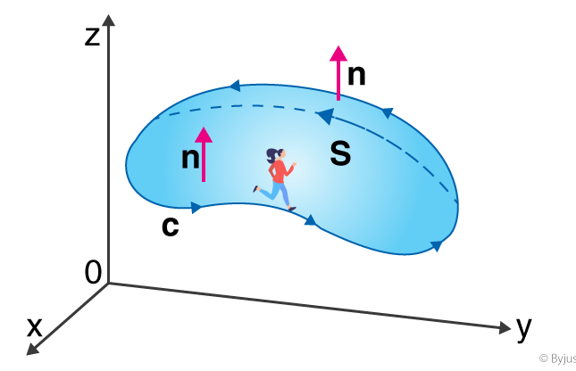
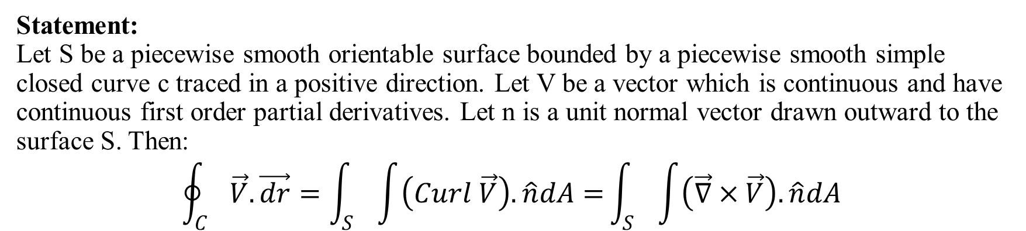
Statement: Let S be a piecewise smooth orientable surface bounded by a piecewise smooth simple closed curve c traced in a positive direction. Let V be a vector which is continuous and have continuous first order partial derivatives. Let n is a unit normal vector drawn outward to the surface S. Then: $$\oint_{C}{\vec{V}.\vec{dr}=\int_{S}{\int{\left(Curl \vec{V}\right).\hat{n}dA=}}}\int_{S}{\int{\left(\vec{∇}×\vec{V}\right).\hat{n}dA}}$$

Slide 3
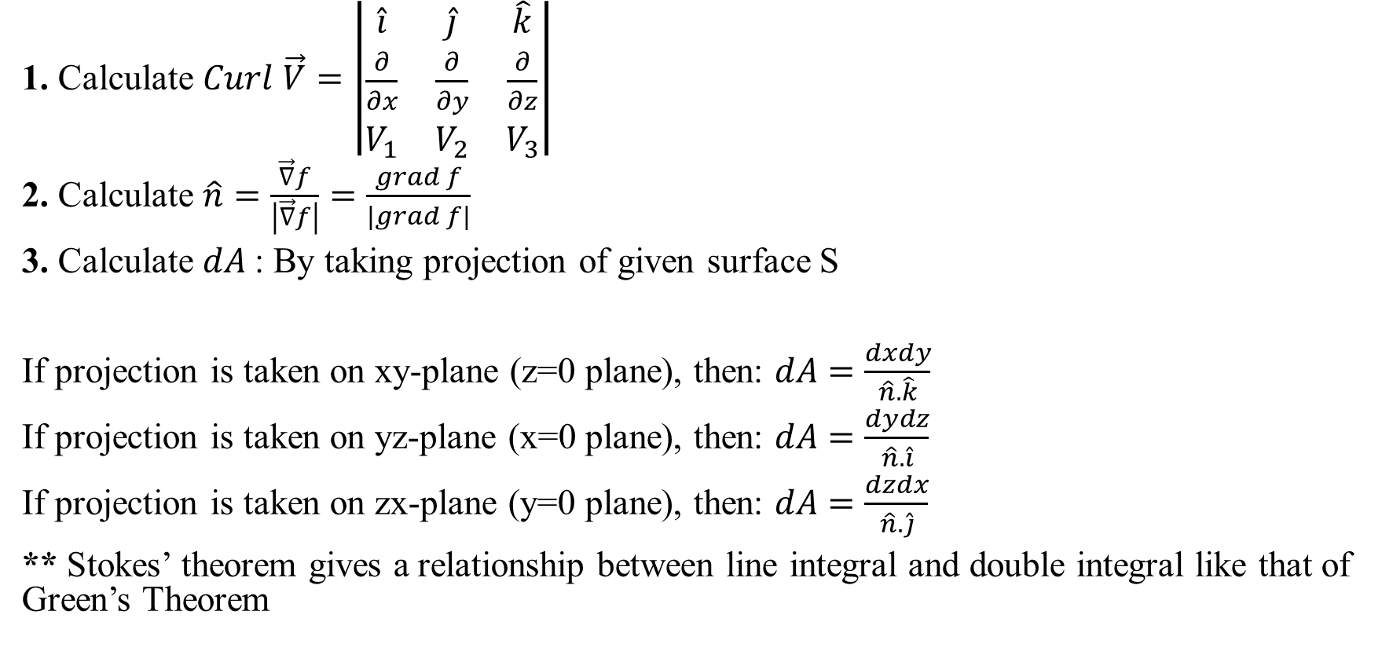
Calculations required to Apply Stokes’ Theorem
1. Calculate $Curl \vec{V}=\left|\begin{matrix}\hat{i} & \hat{j} & \hat{k} \\ \frac{∂}{∂x} & \frac{∂}{∂y} & \frac{∂}{∂z} \\ V_{1} & V_{2} & V_{3}\end{matrix}\right|$
2. Calculate $\hat{n}=\frac{\vec{∇}f}{\left|\vec{∇}f\right|}=\frac{grad f}{\left|grad f\right|}$
3. Calculate $dA$: By taking projection of given surface S
If projection is taken on xy-plane (z=0 plane), then: $dA=\frac{dxdy}{\hat{n}.\hat{k}}$
If projection is taken on yz-plane (x=0 plane), then: $dA=\frac{dydz}{\hat{n}.\hat{i}}$
If projection is taken on zx-plane (y=0 plane), then: $dA=\frac{dzdx}{\hat{n}.\hat{j}}$
** Stokes’ theorem gives a relationship between line integral and double integral like that of Green’s Theorem

Slide 4
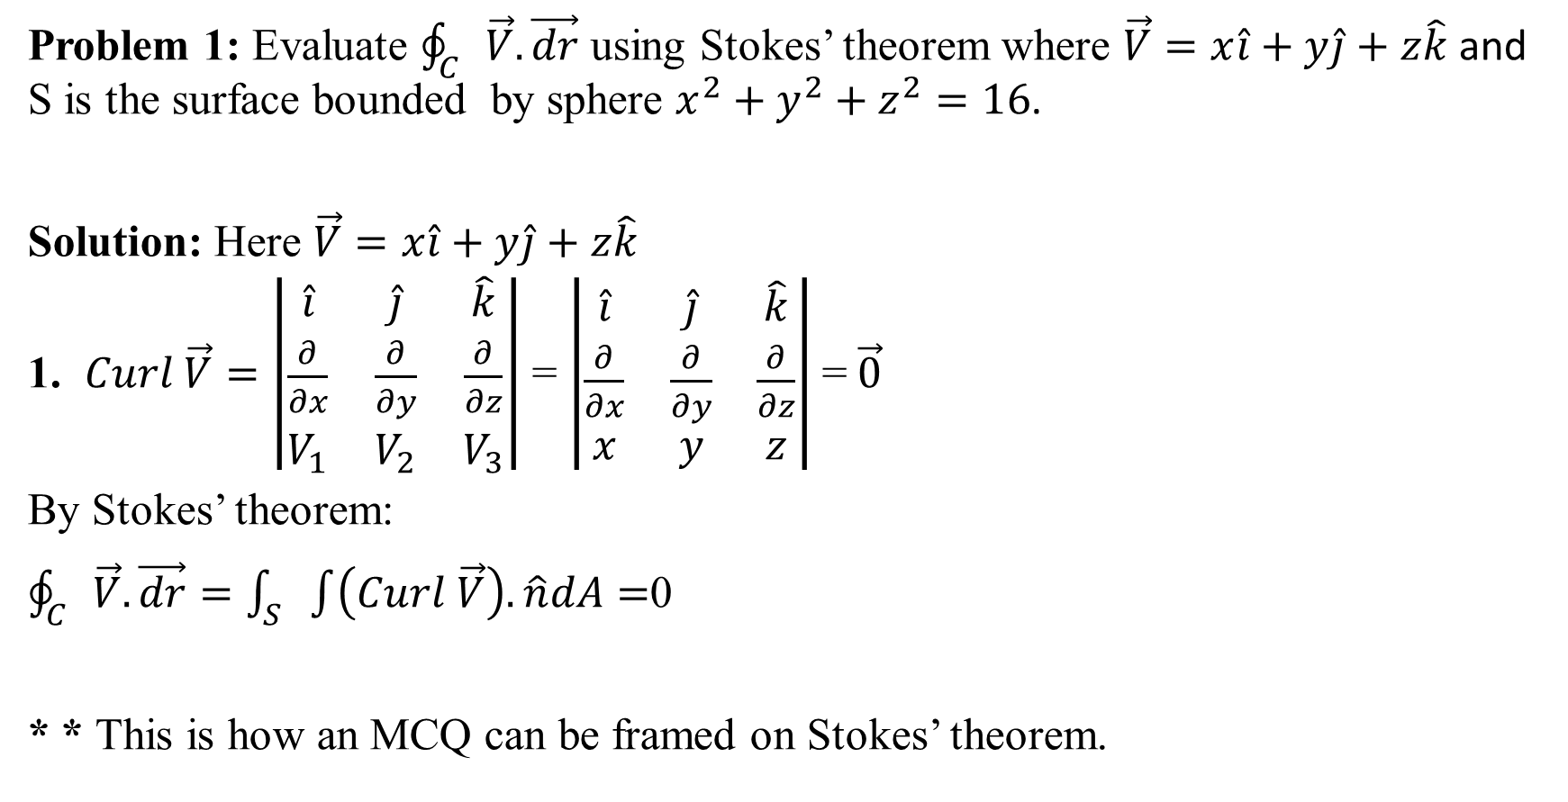
Problem 1: Evaluate $\oint_{C}{\vec{V}.\vec{dr}}$ using Stokes’ theorem where $\vec{V}=x\hat{i}+y\hat{j}+z\hat{k}$ and S is the surface bounded by sphere $x^{2}+y^{2}+z^{2}=16$.
Solution: Here $\vec{V}=x\hat{i}+y\hat{j}+z\hat{k}$
1. $Curl \vec{V}=\left|\begin{matrix}\hat{i} & \hat{j} & \hat{k} \\ \frac{∂}{∂x} & \frac{∂}{∂y} & \frac{∂}{∂z} \\ V_{1} & V_{2} & V_{3}\end{matrix}\right|$ = $\left|\begin{matrix}\hat{i} & \hat{j} & \hat{k} \\ \frac{∂}{∂x} & \frac{∂}{∂y} & \frac{∂}{∂z} \\ x & y & z\end{matrix}\right|$ = $\vec{0}$
By Stokes’ theorem:
$\oint_{C}{\vec{V}.\vec{dr}=\int_{S}{\int{\left(Curl \vec{V}\right).\hat{n}dA=}}}$0
* * This is how an MCQ can be framed on Stokes’ theorem.

Slide 5
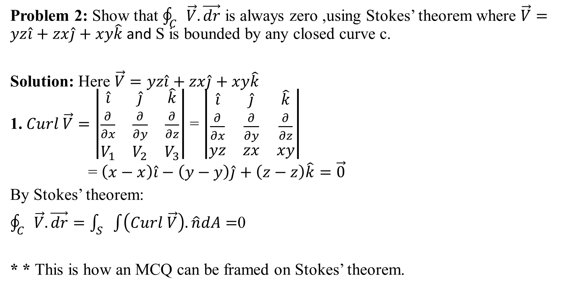
Problem 2: Show that $\oint_{C}{\vec{V}.\vec{dr}}$ is always zero ,using Stokes’ theorem where $\vec{V}=yz\hat{i}+zx\hat{j}+xy\hat{k}$ and S is bounded by any closed curve c.
Solution: Here $\vec{V}=yz\hat{i}+zx\hat{j}+xy\hat{k}$
1. $Curl \vec{V}=\left|\begin{matrix}\hat{i} & \hat{j} & \hat{k} \\ \frac{∂}{∂x} & \frac{∂}{∂y} & \frac{∂}{∂z} \\ V_{1} & V_{2} & V_{3}\end{matrix}\right|$ = $\left|\begin{matrix}\hat{i} & \hat{j} & \hat{k} \\ \frac{∂}{∂x} & \frac{∂}{∂y} & \frac{∂}{∂z} \\ yz & zx & xy\end{matrix}\right|$
= $\left(x−x\right)\hat{i}−\left(y−y\right)\hat{j}+\left(z−z\right)\hat{k}=\vec{0}$
By Stokes’ theorem:
$\oint_{C}{\vec{V}.\vec{dr}=\int_{S}{\int{\left(Curl \vec{V}\right).\hat{n}dA=}}}$0
* * This is how an MCQ can be framed on Stokes’ theorem.

Slide 6
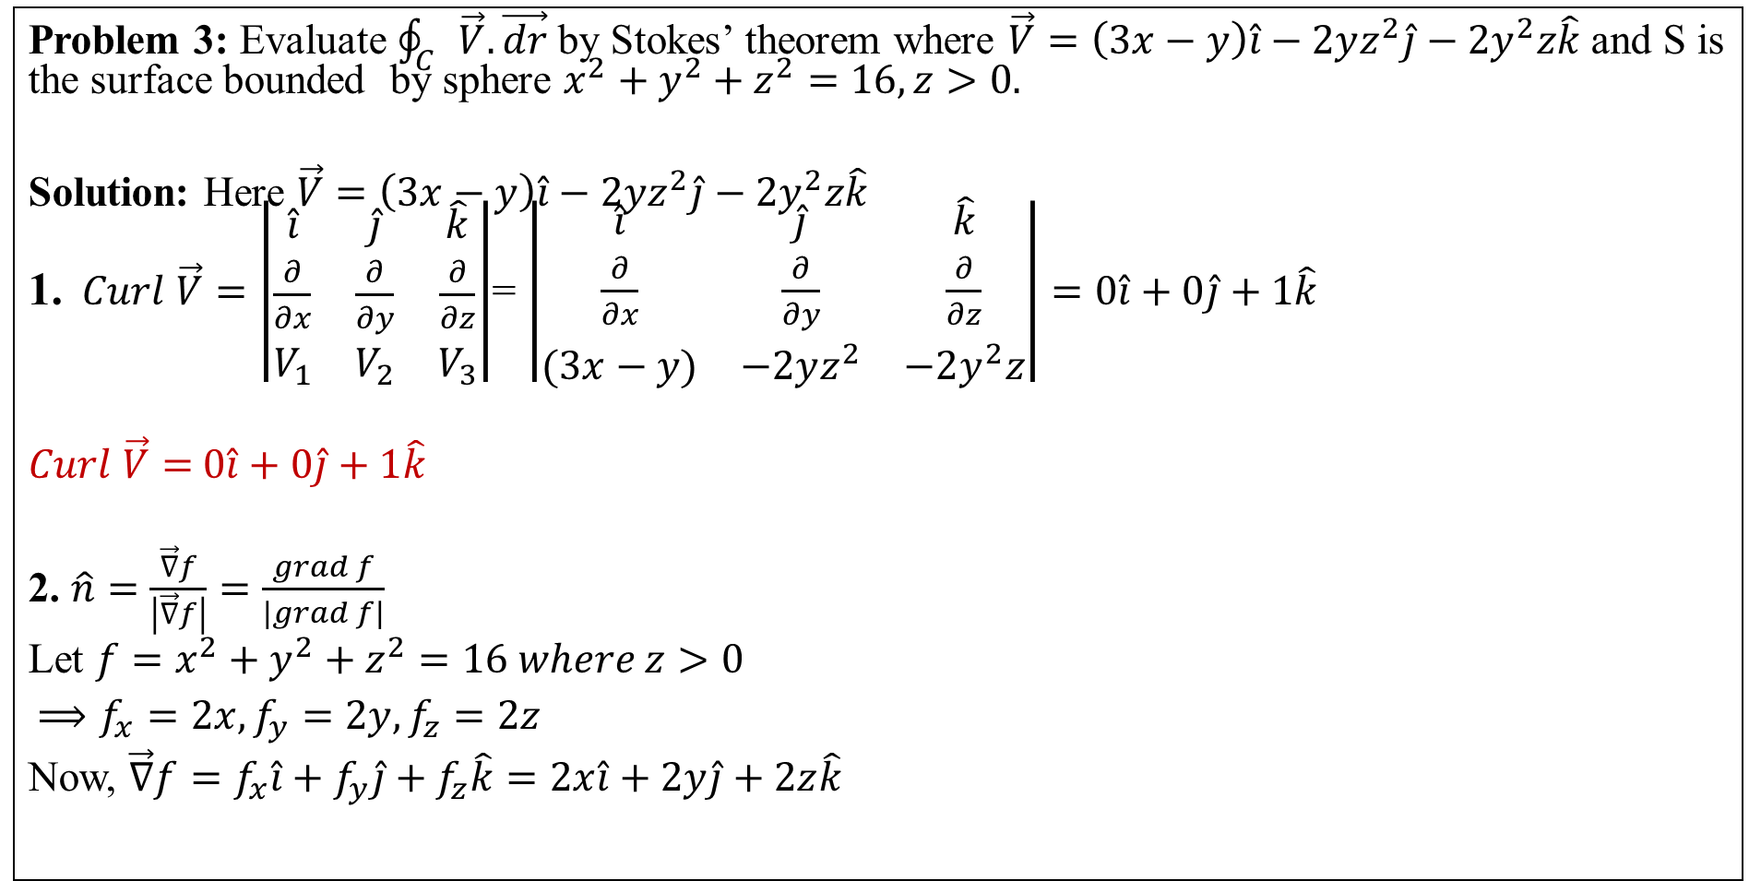
Problem 3: Evaluate $\oint_{C}{\vec{V}.\vec{dr}}$ by Stokes’ theorem where $\vec{V}=\left(3x−y\right)\hat{i}−2yz^{2}\hat{j}−2y^{2}z\hat{k}$ and S is the surface bounded by sphere $x^{2}+y^{2}+z^{2}=16, z>0.$
Solution: Here $\vec{V}=\left(3x−y\right)\hat{i}−2yz^{2}\hat{j}−2y^{2}z\hat{k}$
1. $Curl \vec{V}=\left|\begin{matrix}\hat{i} & \hat{j} & \hat{k} \\ \frac{∂}{∂x} & \frac{∂}{∂y} & \frac{∂}{∂z} \\ V_{1} & V_{2} & V_{3}\end{matrix}\right|$= $\left|\begin{matrix}\hat{i} & \hat{j} & \hat{k} \\ \frac{∂}{∂x} & \frac{∂}{∂y} & \frac{∂}{∂z} \\ (3x−y) & −2yz^{2} & −2y^{2}z\end{matrix}\right|=0\hat{i}+0\hat{j}+1\hat{k}$
$Curl \vec{V}=$ $0\hat{i}+0\hat{j}+1\hat{k}$
2. $\hat{n}=\frac{\vec{∇}f}{\left|\vec{∇}f\right|}=\frac{grad f}{\left|grad f\right|}$
Let ${f=x}^{2}+y^{2}+z^{2}=16 where z>0$
$⟹f_{x}=2x,f_{y}=2y,f_{z}=2z$
Now, $\vec{∇}f=f_{x}\hat{i}+f_{y}\hat{j}+f_{z}\hat{k}=2x\hat{i}+2y\hat{j}+2z\hat{k}$

Slide 7
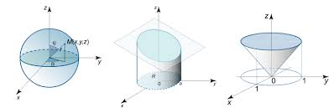
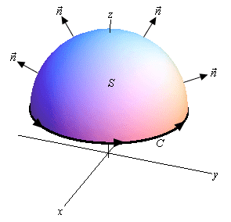

$\hat{n}=\frac{\vec{∇}f}{\left|\vec{∇}f\right|}=\frac{\left(2x\hat{i}+2y\hat{j}+2z\hat{k}\right)}{\sqrt{{4x}^{2}+{4y}^{2}+{4z}^{2}}}$
$\hat{n}=\frac{2\left(x\hat{i}+y\hat{j}+z\hat{k}\right)}{2\sqrt{x^{2}+y^{2}+z^{2}}}=\frac{\left(x\hat{i}+y\hat{j}+z\hat{k}\right)}{\sqrt{16}}$
$\hat{n}=\frac{\left(x\hat{i}+y\hat{j}+z\hat{k}\right)}{4}$
3. To find dA: Let the projection of surface S be taken on xy-plane.(z=0) The sphere becomes a circle of radius 4, $x^{2}+y^{2}+0^{2}=16$ that is $x^{2}+y^{2}=16$

Slide 8

$dA=\frac{dxdy}{\hat{n}.\hat{k}}=\frac{dxdy}{\frac{\left(x\hat{i}+y\hat{j}+z\hat{k}\right)}{4 }.\hat{k}}$
$dA=\frac{dxdy}{\frac{\left(z\right)}{4 } }$
By Stokes’ Theorem:
$\oint_{C}{\vec{V}.\vec{dr}=\int_{S}{\int{\left(Curl \vec{V}\right).\hat{n}dA}}}$
$=\int_{S}{\int{[\left(0\hat{i}+0\hat{j}+1\hat{k}\right).\frac{\left(x\hat{i}+y\hat{j}+z\hat{k}\right)}{4}]\frac{dxdy}{\frac{\left(z\right)}{4 } }}}$
$=\int_{S}{\int{\frac{\left(z\right)}{4 }\frac{dxdy}{\frac{\left(z\right)}{4 } }}}$ $=\int_{S}{\int{dxdy}=}$ Area of a circle $x^{2}+y^{2}=16$
$=πr^{2}=π\left(4^{2}\right)=16π$ Answer.

Slide 9
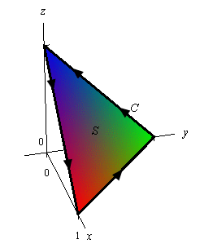
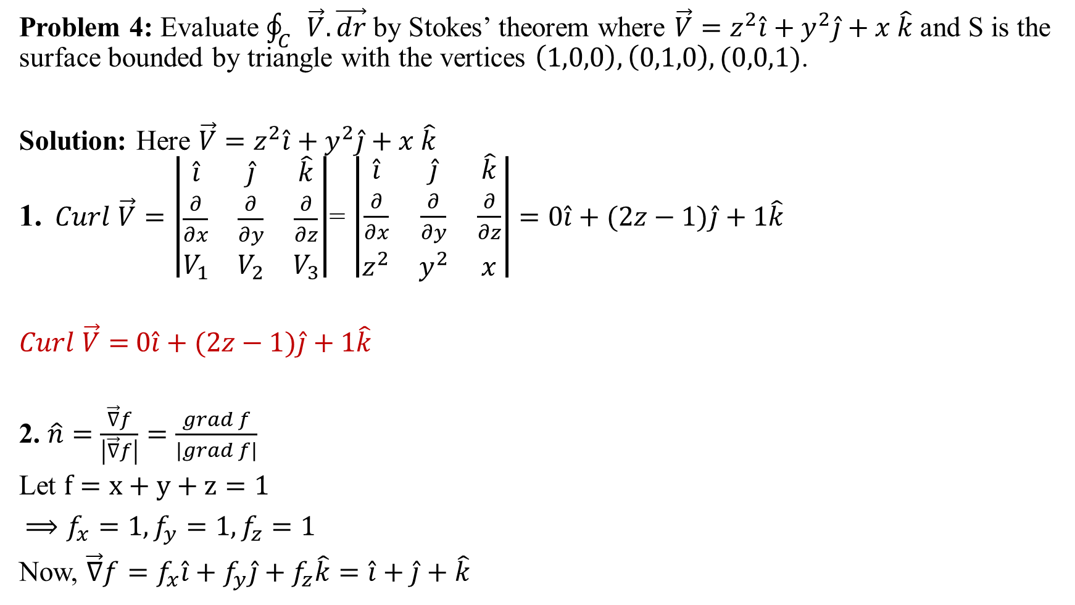
Problem 4: Evaluate $\oint_{C}{\vec{V}.\vec{dr}}$ by Stokes’ theorem where $\vec{V}=z^{2}\hat{i}+y^{2}\hat{j}+x \hat{k}$ and S is the surface bounded by triangle with the vertices $\left(1,0,0\right),\left(0,1,0\right),(0,0,1)$.
Solution: Here $\vec{V}=z^{2}\hat{i}+y^{2}\hat{j}+x \hat{k}$
1. $Curl \vec{V}=\left|\begin{matrix}\hat{i} & \hat{j} & \hat{k} \\ \frac{∂}{∂x} & \frac{∂}{∂y} & \frac{∂}{∂z} \\ V_{1} & V_{2} & V_{3}\end{matrix}\right|$= $\left|\begin{matrix}\hat{i} & \hat{j} & \hat{k} \\ \frac{∂}{∂x} & \frac{∂}{∂y} & \frac{∂}{∂z} \\ z^{2} & y^{2} & x\end{matrix}\right|=0\hat{i}+(2z−1)\hat{j}+1\hat{k}$
$Curl \vec{V}=$ $0\hat{i}+(2z−1)\hat{j}+1\hat{k}$
2. $\hat{n}=\frac{\vec{∇}f}{\left|\vec{∇}f\right|}=\frac{grad f}{\left|grad f\right|}$
Let $f=x+y+z=1$
$⟹f_{x}=1,f_{y}=1,f_{z}=1$
Now, $\vec{∇}f=f_{x}\hat{i}+f_{y}\hat{j}+f_{z}\hat{k}=\hat{i}+\hat{j}+\hat{k}$

Slide 10
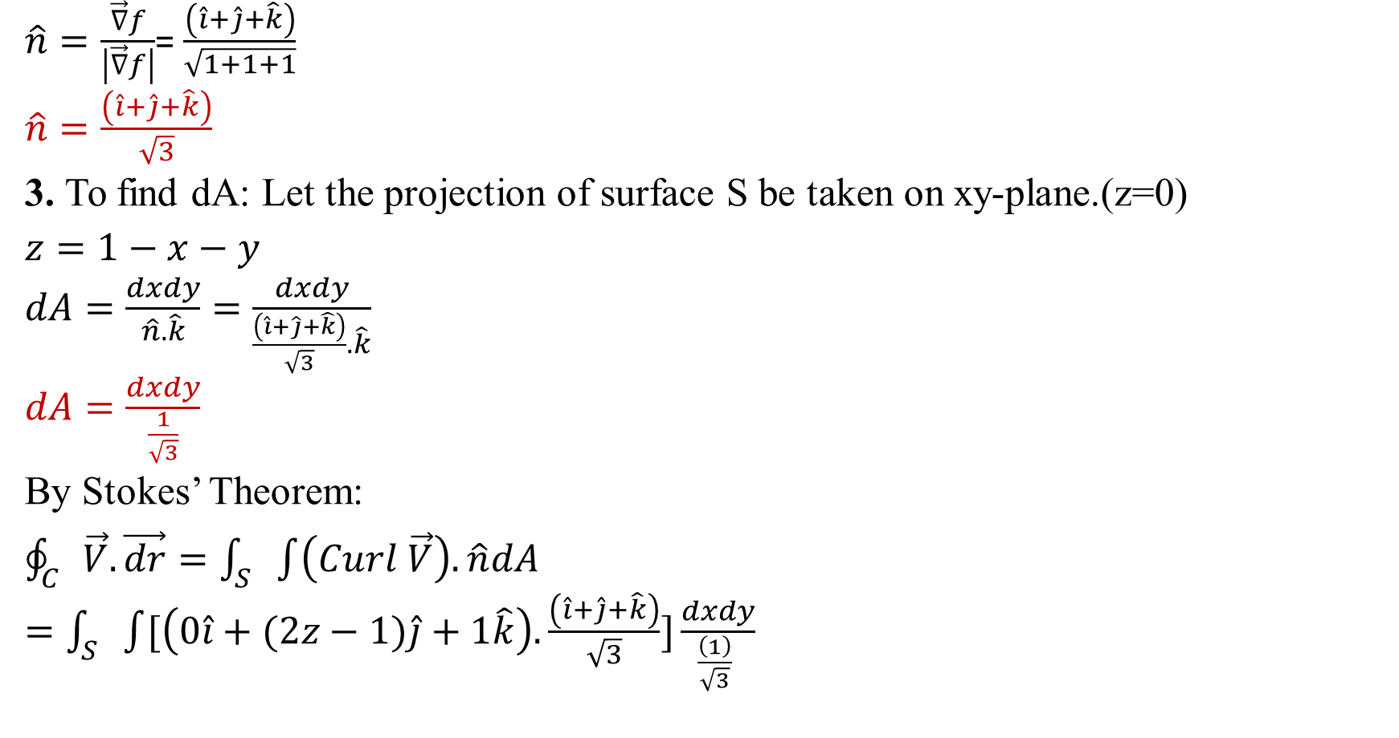
$\hat{n}=\frac{\vec{∇}f}{\left|\vec{∇}f\right|}$= $\frac{\left(\hat{i}+\hat{j}+\hat{k}\right)}{\sqrt{1+1+1}}$
$\hat{n}=\frac{\left(\hat{i}+\hat{j}+\hat{k}\right)}{\sqrt{3}}$
3. To find dA: Let the projection of surface S be taken on xy-plane.(z=0)
$z=1−x−y$
$dA=\frac{dxdy}{\hat{n}.\hat{k}}=\frac{dxdy}{\frac{\left(\hat{i}+\hat{j}+\hat{k}\right)}{\sqrt{3}}.\hat{k}}$
$dA=\frac{dxdy}{\frac{1}{\sqrt{3}}}$
By Stokes’ Theorem:
$\oint_{C}{\vec{V}.\vec{dr}=\int_{S}{\int{\left(Curl \vec{V}\right).\hat{n}dA}}}$
$=\int_{S}{\int{[\left(0\hat{i}+(2z−1)\hat{j}+1\hat{k}\right).\frac{\left(\hat{i}+\hat{j}+\hat{k}\right)}{\sqrt{3}}]\frac{dxdy}{\frac{\left(1\right)}{\sqrt{3}} }}}$

Slide 11

$=\int_{S}{\int{[2\left(1−x−y\right)−1]}}dxdy$
$=\int_{x=0}^{1}{\int_{y=0}^{1−x}{\left[2\left(1−x−y\right)−1\right]dydx}}$
$=\int_{x=0}^{1}{{\left[y−2xy−y^{2}\right]}_{y=0}^{y=1−x}dx}$
$=\int_{x=0}^{1}{\left(x^{2}−x\right)dx}$
${=\left[\frac{x^{3}}{3}−\frac{x^{2}}{2}\right]}_{x=0}^{1}$
$=\frac{1}{3}−\frac{1}{2}$
$=\frac{1}{6}$ Answer

Slide 12
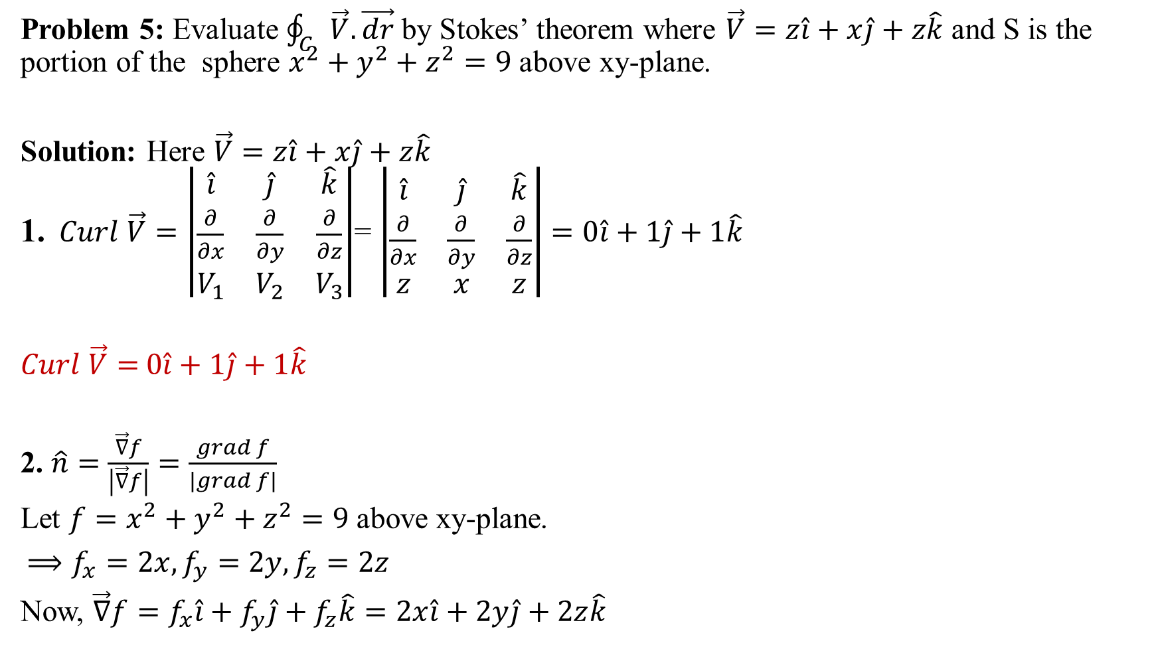
Problem 5: Evaluate $\oint_{C}{\vec{V}.\vec{dr}}$ by Stokes’ theorem where $\vec{V}=z\hat{i}+x\hat{j}+z\hat{k}$ and S is the portion of the sphere $x^{2}+y^{2}+z^{2}=9$ above xy-plane.
Solution: Here $\vec{V}=z\hat{i}+x\hat{j}+z\hat{k}$
1. $Curl \vec{V}=\left|\begin{matrix}\hat{i} & \hat{j} & \hat{k} \\ \frac{∂}{∂x} & \frac{∂}{∂y} & \frac{∂}{∂z} \\ V_{1} & V_{2} & V_{3}\end{matrix}\right|$= $\left|\begin{matrix}\hat{i} & \hat{j} & \hat{k} \\ \frac{∂}{∂x} & \frac{∂}{∂y} & \frac{∂}{∂z} \\ z & x & z\end{matrix}\right|=0\hat{i}+1\hat{j}+1\hat{k}$
$Curl \vec{V}=$ $0\hat{i}+1\hat{j}+1\hat{k}$
2. $\hat{n}=\frac{\vec{∇}f}{\left|\vec{∇}f\right|}=\frac{grad f}{\left|grad f\right|}$
Let ${f=x}^{2}+y^{2}+z^{2}=9$above xy-plane.
$⟹f_{x}=2x,f_{y}=2y,f_{z}=2z$
Now, $\vec{∇}f=f_{x}\hat{i}+f_{y}\hat{j}+f_{z}\hat{k}=2x\hat{i}+2y\hat{j}+2z\hat{k}$

Slide 13
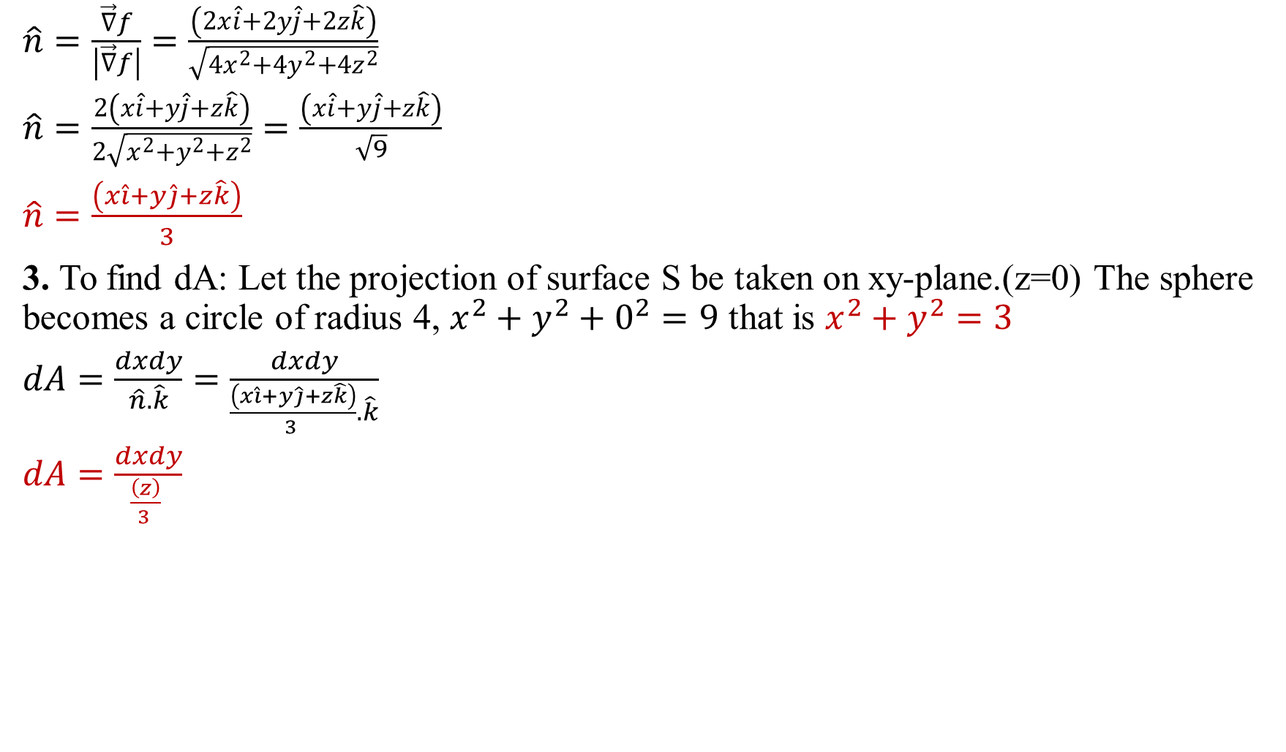
$\hat{n}=\frac{\vec{∇}f}{\left|\vec{∇}f\right|}=\frac{\left(2x\hat{i}+2y\hat{j}+2z\hat{k}\right)}{\sqrt{{4x}^{2}+{4y}^{2}+{4z}^{2}}}$
$\hat{n}=\frac{2\left(x\hat{i}+y\hat{j}+z\hat{k}\right)}{2\sqrt{x^{2}+y^{2}+z^{2}}}=\frac{\left(x\hat{i}+y\hat{j}+z\hat{k}\right)}{\sqrt{9}}$
$\hat{n}=\frac{\left(x\hat{i}+y\hat{j}+z\hat{k}\right)}{3}$
3. To find dA: Let the projection of surface S be taken on xy-plane.(z=0) The sphere becomes a circle of radius 4, $x^{2}+y^{2}+0^{2}=9$ that is $x^{2}+y^{2}=3$
$dA=\frac{dxdy}{\hat{n}.\hat{k}}=\frac{dxdy}{\frac{\left(x\hat{i}+y\hat{j}+z\hat{k}\right)}{3 }.\hat{k}}$
$dA=\frac{dxdy}{\frac{\left(z\right)}{3 } }$

Slide 14
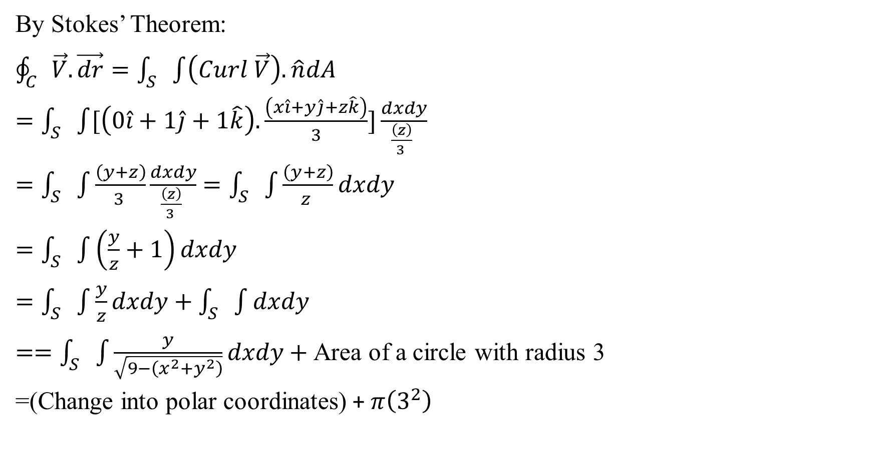
By Stokes’ Theorem:
$\oint_{C}{\vec{V}.\vec{dr}=\int_{S}{\int{\left(Curl \vec{V}\right).\hat{n}dA}}}$
$=\int_{S}{\int{[\left(0\hat{i}+1\hat{j}+1\hat{k}\right).\frac{\left(x\hat{i}+y\hat{j}+z\hat{k}\right)}{3}]\frac{dxdy}{\frac{\left(z\right)}{3 } }}}$
$=\int_{S}{\int{\frac{\left(y+z\right)}{3 }\frac{dxdy}{\frac{\left(z\right)}{3 } }}}$ $=\int_{S}{\int{\frac{\left(y+z\right)}{z }dxdy}}$
$=\int_{S}{\int{\left(\frac{y}{z}+1\right)dxdy}}$
$=\int_{S}{\int{\frac{y}{z}dxdy}}+$ $\int_{S}{\int{dxdy}}$
$==\int_{S}{\int{\frac{y}{\sqrt{9−\left(x^{2}+y^{2}\right)}}dxdy}+ }$Area of a circle with radius 3
=(Change into polar coordinates) + $π\left(3^{2}\right)$

Slide 15

$=\left(x=r\cos{θ, y=r\sin{θ, 0≤r≤3, 0≤θ≤2π}}\right)+9π$
$=\int_{r=0}^{3}{\int_{θ=0}^{2π}{\frac{r\sin{θ}}{\sqrt{9−r^{2}}}rdrdθ}}+9π$
$=\int_{r=0}^{3}{\frac{r^{2}}{\sqrt{9−r^{2}}}dr\int_{θ=0}^{2π}{\sin{θ}dθ}+9π}$
Simplify it.

Slide 16

This Photo by Unknown Author is licensed under CC BY-NC-ND

